Slide 1
BBM 311: BANKING THEORY AND PRACTICE
Introduction

Slide 2
Introduction to banking
(Commercial) Banks are financial intermediaries that
safeguard,
transfer,
Exchange, and
Lend money
Similar institutions that carry out functions similar to banks, but are not actually commercial banks are called SHADOW BANKS
Examples include SACCOS, Investment banks, Brokerage houses, …..

Slide 3
Introduction to banking
Mergers, technology, and competition have reshaped banking.
A merger occurs when one or more banks join or acquire another bank or banks. Mergers increase the size of banks, giving them more resources. Mergers also decrease the number of banks.
Banks are larger and ownership is concentrated. Fewer banks control more and more of the nation's money.
CFC merger with Stanbic, Eco Bank acquires EABS, Guaranty Trust Bank, GTB acquires 70% stake in Fina Bank, I&M bank acquired by City Trust LTD ……………..

Slide 4
Introduction to banking ………………
Banks compete not only with other banks, but with other businesses that sell financial services, such as credit unions
Competition has resulted in
mergers and decreasing numbers of banks,
more services available to consumers, as banks compete to earn customers' financial business..
Banks are more sales oriented than ever, with an emphasis on service, innovation, and marketing.

Slide 5
Introduction to banking ………………
Fast and efficient technology has
Taken over accounting, auditing, and examining, funds transfer, record keeping, and financial analyses making them instantaneous
Ended the 9.00am to 3.00 pm bank hours due to emergence of ATMs, credit cards, mobile and internet banking.

Slide 6
Introduction to banking ………………
Role of banks in the economy
1. Safeguard money through business practices that
Protect: transfer security, identification, enforcement,
Record (via record keeping) and,
Evaluating banking transactions.
Sound business practices- judgement, staff training, …..
Expand the economy by
Transferring and,
Lending money to creditworthy borrowers
And hence support markets and provide stimulus for job creation.

Slide 7
Introduction to banking ………………
How the banking system works….
1. Banks make money on the SPREAD between interest paid on deposits and that received from loans.
2. Other sources of income include transaction fees, e.g. when you withdraw over the counter or ATM, Check clearance, Local and international cash transfer, e.t.c.
3. Note that deposits are liabilities. Loans and advances are assets.

Slide 8
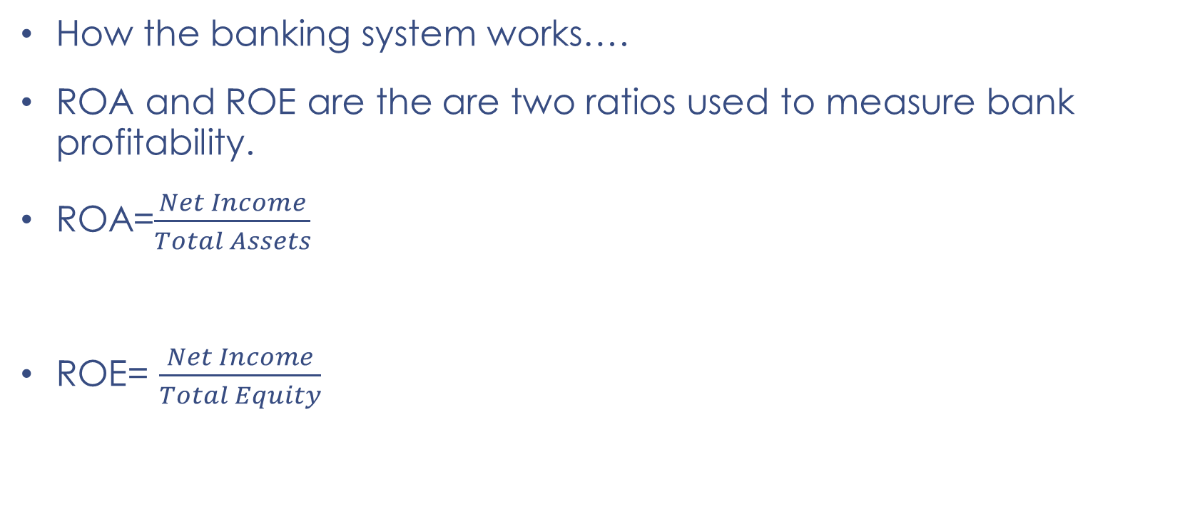
Introduction to banking ………………
How the banking system works….
ROA and ROE are the are two ratios used to measure bank profitability.
ROA=$\frac{Net Income}{Total Assets}$
ROE= $\frac{Net Income}{Total Equity}$

Slide 9
Other financial intermediaries….
Deposit intermediaries, are financial institutions (such as commercial banks, deposit taking microfinance or credit union, SACCO) that is legally allowed to accept monetary deposits from consumers. It contributes to the economy by lending much of the money saved by depositors.
Non-depository intermediaries are financial intermediaries that do not accept deposits but do pool the payments of many people in the form of premiums or contributions and either invest it or provide credit to others - Insurance companies, Investment banks, stock brokerage houses, pension funds…..

Slide 10
Title and Content Layout with Chart

Slide 11
Two Content Layout with Table
First bullet point here
Second bullet point here
Third bullet point here
 | Group A | Group B
Class 1 | 82 | 95
Class 2 | 76 | 88
Class 3 | 84 | 90

Slide 12
Two Content Layout with SmartArt
Group A
Task 1
Task 2
Group B
Task 1
Task 2
Group C
Task 1
First bullet point here
Second bullet point here
Third bullet point here

